Slide 1

JAMBOARD- a Google tool for online practice and evaluation
Teacher:Hoduț Natalia
Liceul Greco-Catolic “Iuliu Maniu” Oradea

Slide 2
Some technical information about the Jamboard
an interactive whiteboard system developed by Google as part of Google Workspace, formerly known as G Suite
an entire class can join the same jam from other Jamboards and phones and tablets with the Jamboard app
Once created, it automatically saves in Google Drive, but you can also save it as PDF in your computer

Slide 3
you can rename it, save a copy in your Drive share it to your students or other teachers
pupils can view it or edit it
you can create it before the class or open a new one during the Meet class

Slide 4
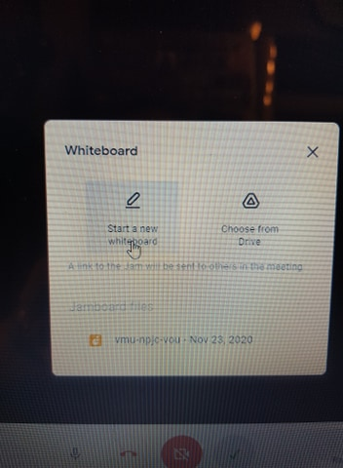
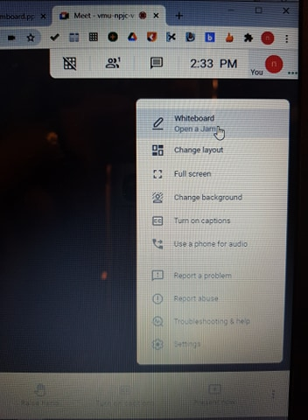
Using a Jam during the Meet class
You can open a Jam during the Meet class and pupils get the link to join it in their Chat box.

Slide 5
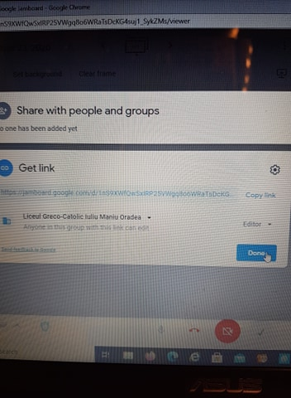
Sharing the jam link

Slide 6
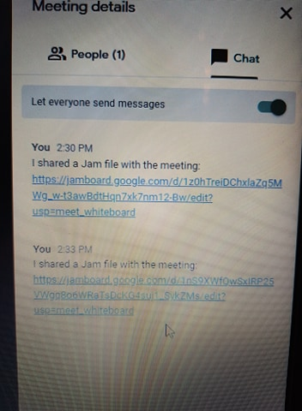
The link is shared in the chat and pupils can join the Jam

Slide 7
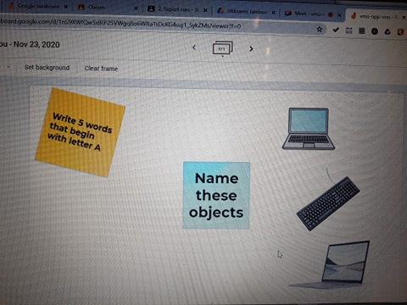
Here is a simple vocabulary example created in a Jam

Slide 8
Using Jamboard that is created before the class
the link may be attached in the Google Classroom
Pupils may just view it or edit it
The teacher can change the settings during the class from Viewer to Editor
They can join during a class to do it
Teachers can send one to each pupil so they do it as homework or individual practice

Slide 9
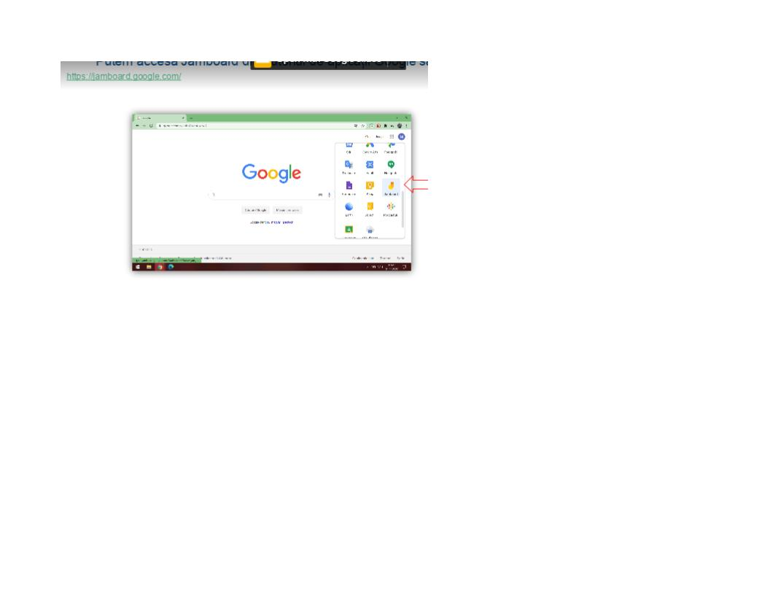
We can access the Jamboard from the list of Google applications or from the link: https://jamboard.google.com

Slide 10
Strengths + and weaknesses –
+You can create as many frames as you want/need/add more during the Meet class
+ You get feedback from pupils in REAL time
+ It is interactive, pupils get involved
+ They can be adapted to all levels and types of activities, skills, vocabulary and grammar practice
+ Easy to create, add photos from the internet directly, add sticky notes or texts

Slide 11
Strengths +
+ can be used as class work /homework/ as evaluation
+ useful for practising writing skills in real time and the teacher can evaluate students’ work better
+ each student can work on it
+it is fun to use and make pupils enjoy online classes more

Slide 12
weaknesses –
Pupils may get too excited about it and work all at the same time, if they are editors from the beginning.
Solution: to view it first, wait for teacher’s explanations and only then become editors and do the task
-one frame may not be big enough for some activities

Slide 13
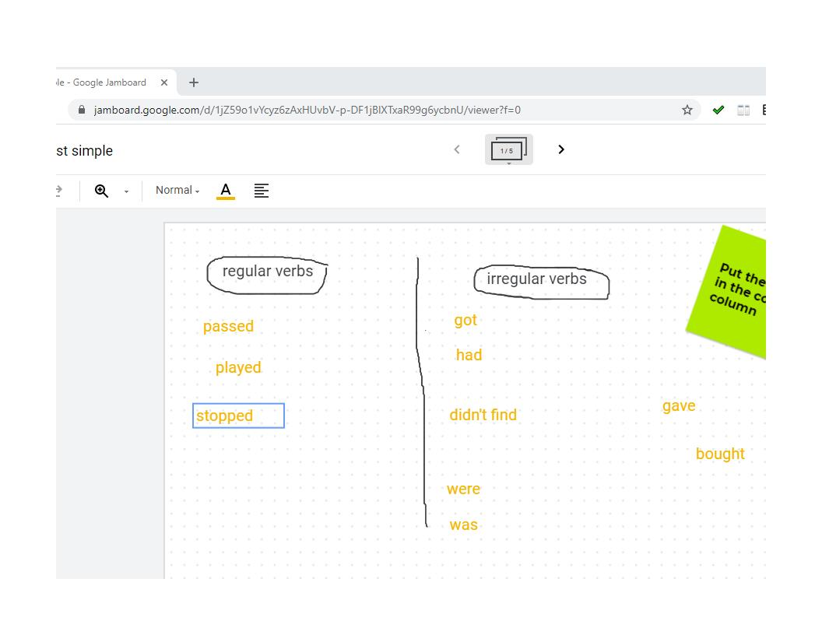
Here are some examples of Jamboard-FOR GRAMMAR PRACTICE

Slide 14
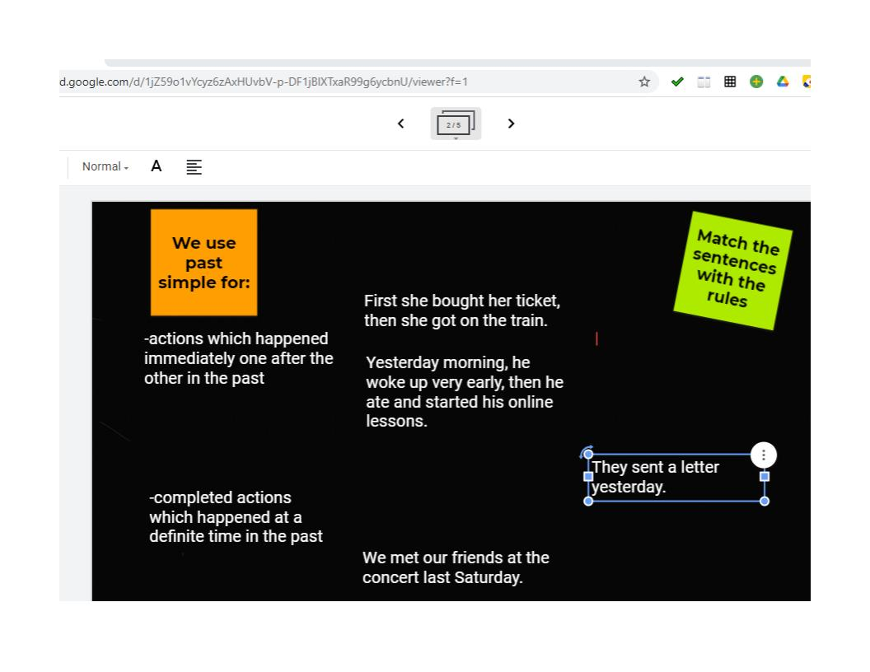
MORE GRAMMAR EXAMPLES

Slide 15
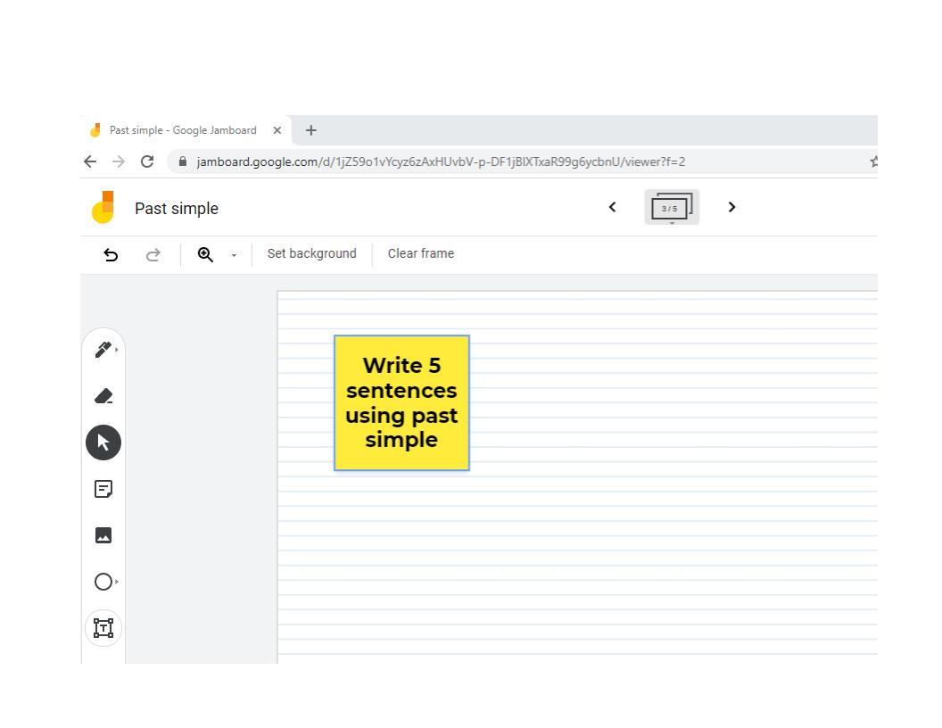

Slide 16
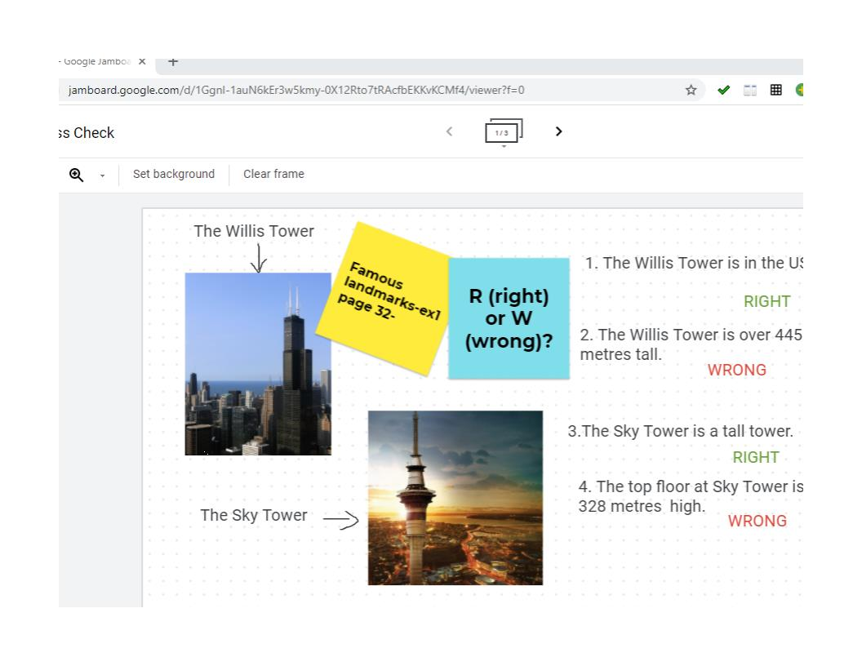
READING COMPREHENSION EXERCISE

Slide 17
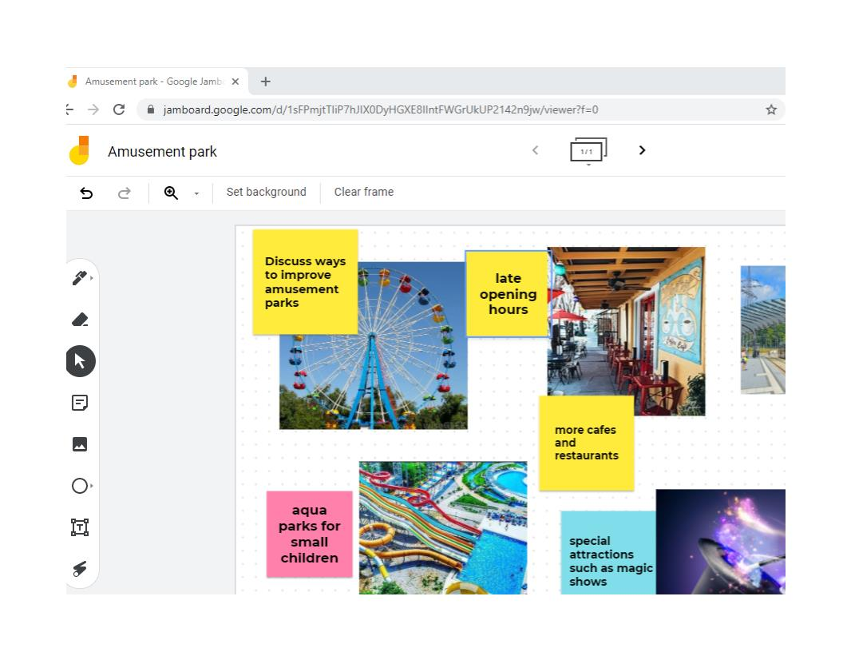
SPEAKING PRACTICE

Slide 18
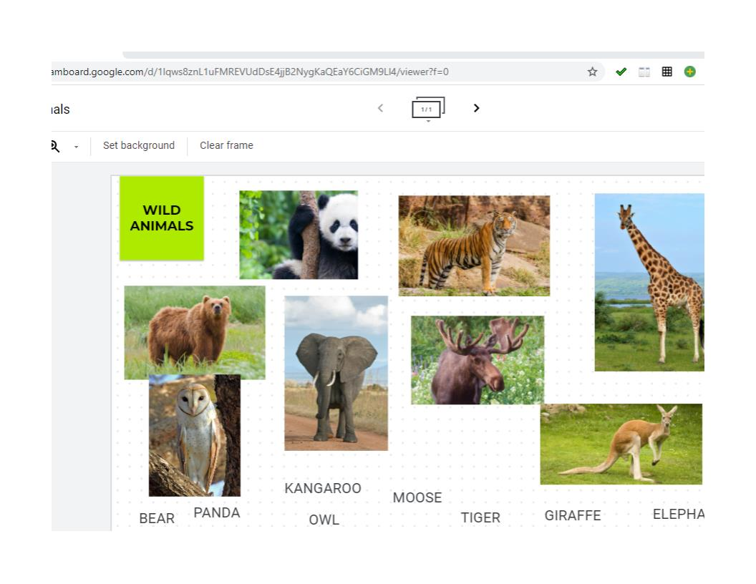
Vocabulary practice- primary students

Slide 19
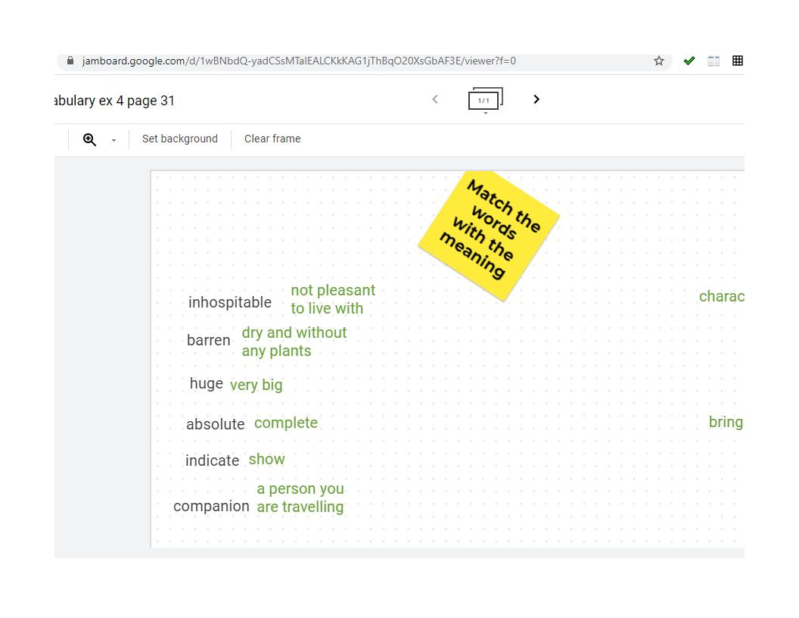
Secondary students

Slide 20
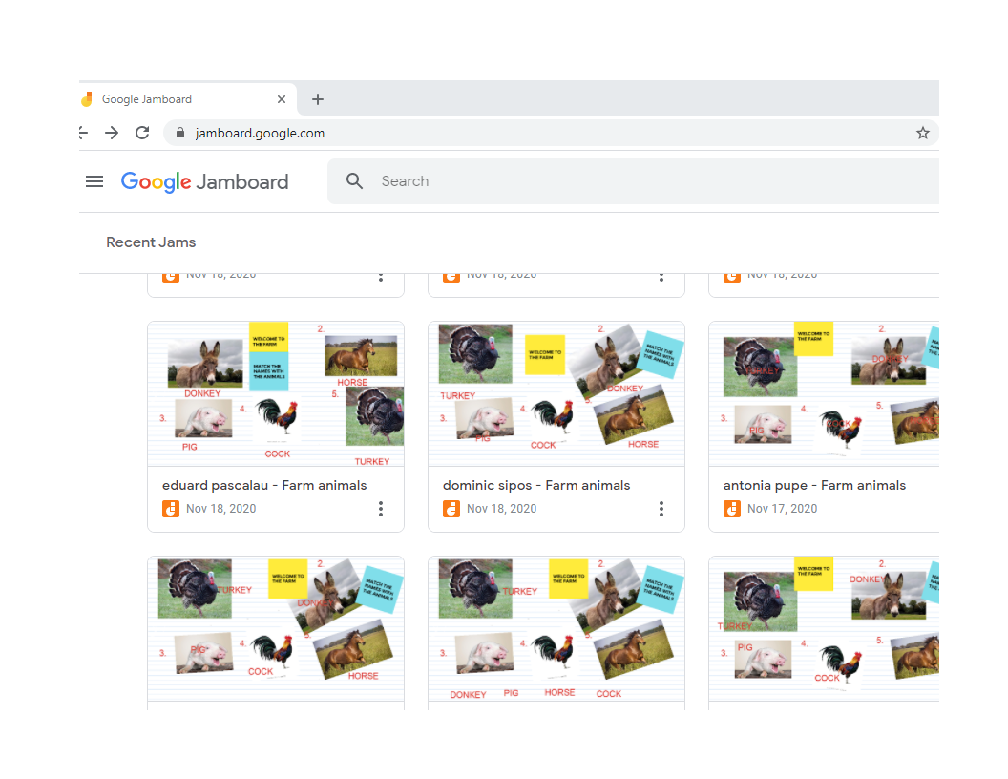
Homework-individual Jamboard

Slide 21
Thank you for listening!
We are happy to tell you that our school is the winner of an Erasmus KA101 project : ”Together for future” and 9 teachers will participate during 2020-2021 at different trainings in EU

