Slide 1
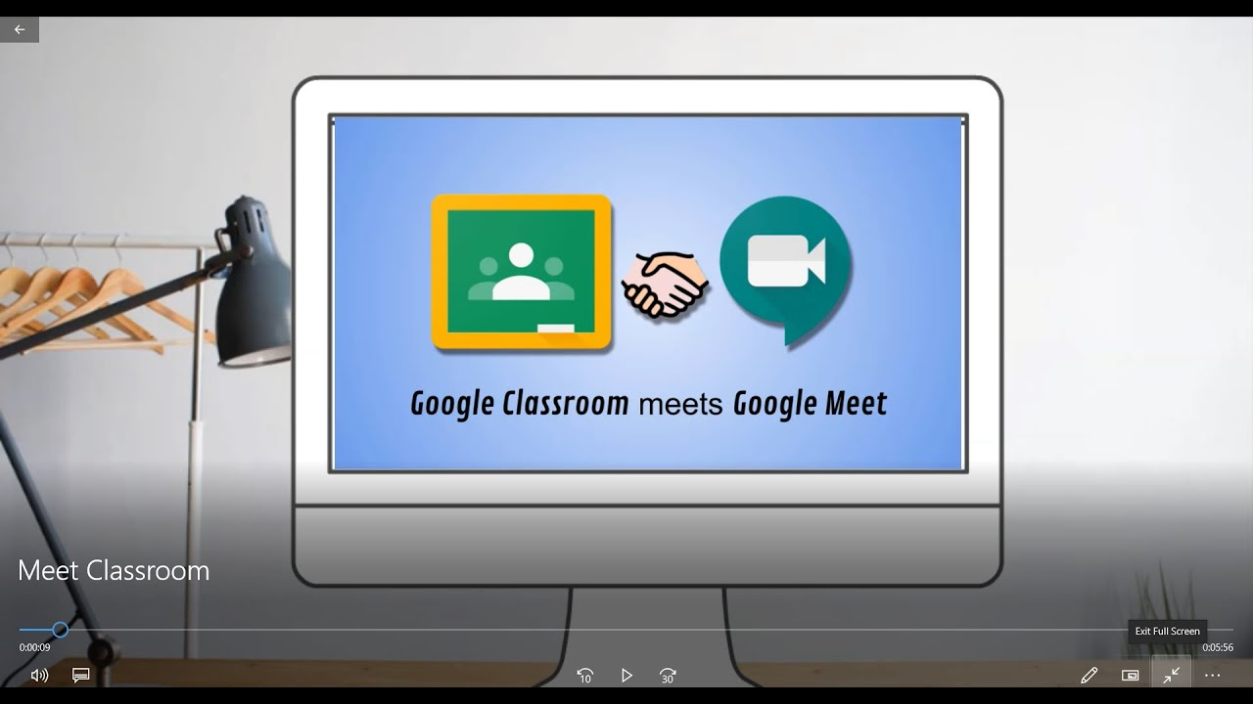
Online teaching strategies for primary school students
Ioana-Paula Hice
Liceul Ortodox ,,Episcop Roman Ciorogariu” , Oradea

Slide 2
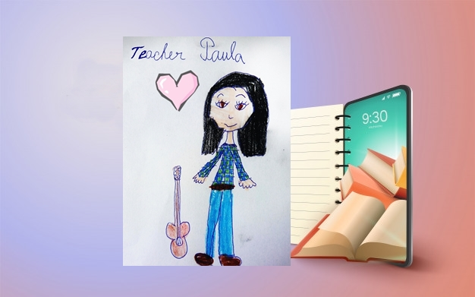
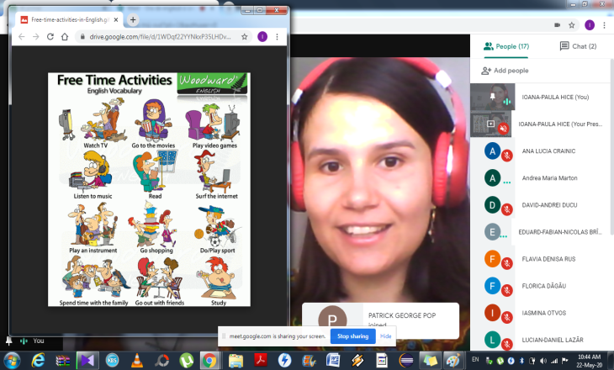
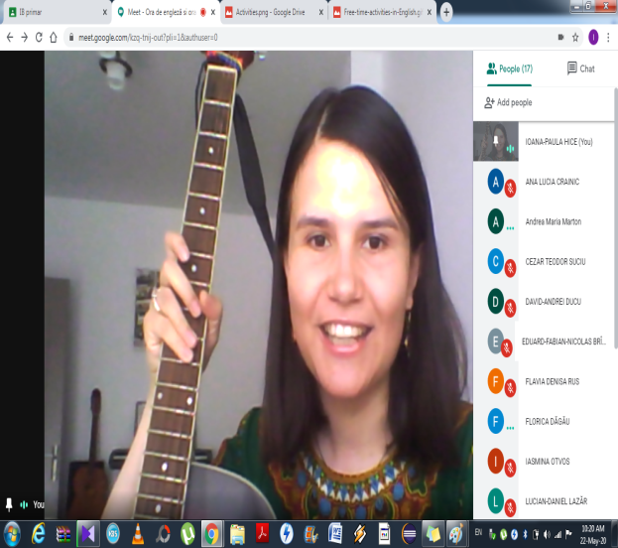
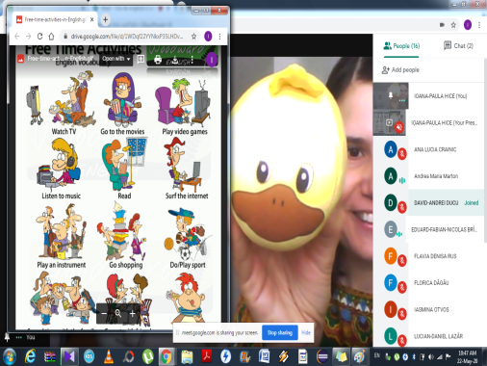

Slide 3
Table of contents:
1. Course objectives
4. Strategies for online activities
5. Examples of online activities
6. Moments from meetings/materials/resources

Slide 4

Course objectives:
Create online teaching strategies
Use Google Classroom and Google Meet for online teaching (primary school students).
Provide teachers with both useful and reliable sources of information (links)
Provide students with audio-visual materials.

Slide 5
Google Classroom-strategies:
Steps for an inspiring lesson (for primary school students):
Use online resources to create your own classroom materials.
Use visual prompts.
A visual prompt includes pictures or photographs, that provide the children with information about how to use the target skill or behavior.
Use short movies and YouTube videos.
Use the Digital Book and post the link .
Assess the students’ activity. (homework, quizzes (Google Forms), role plays, picture descriptions, poems, songs etc.)
Post (“How to…”) tutorials. Students need this kind of information. Give moral and TECHNICAL SUPPORT!

Slide 6
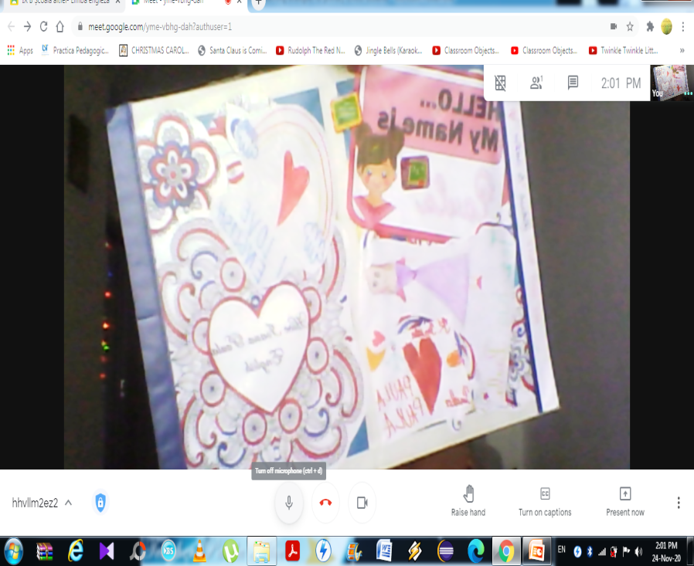
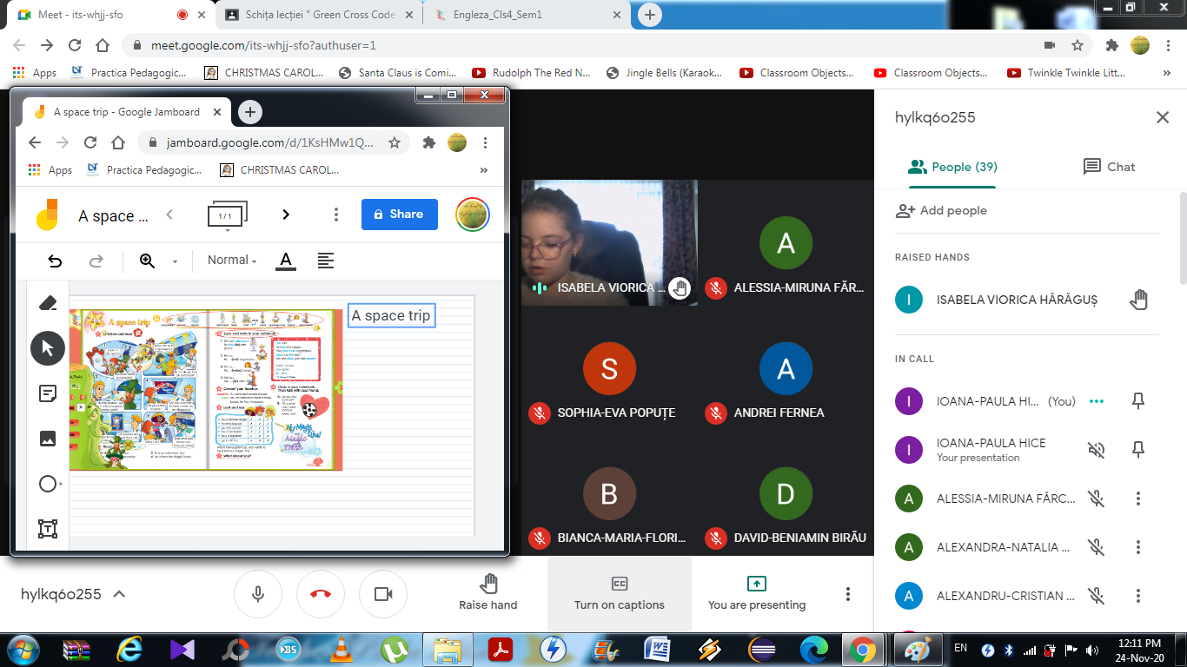
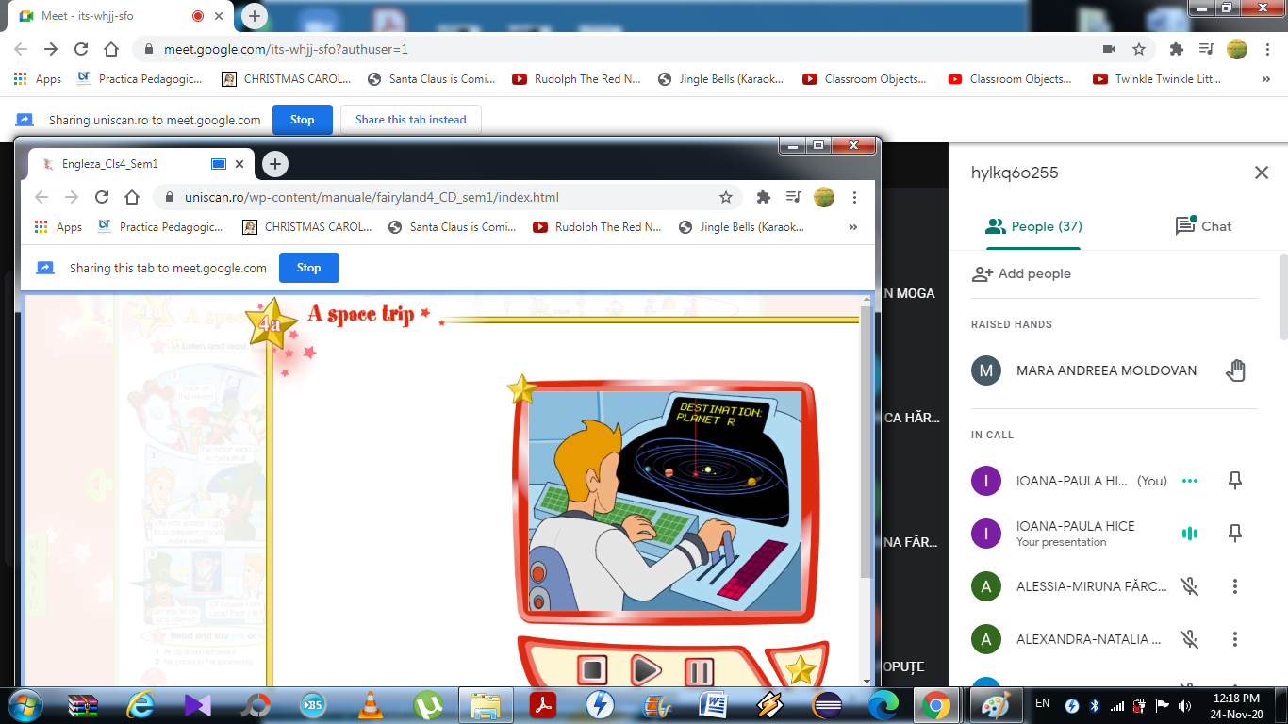
Examples of Google Meet activities- primary school students

Slide 7
Google Meet- Strategies:
Steps for an inspiring online lesson (for primary school students):
-Use online resources to arise interest.
-Use audio-visuals.
-Use visual prompts. Share them! (Click→ Present now→ Your entire screen/A window!)
-Use short movies and YouTube videos. Share them!
(Click→ Present now→ A Chrome tab!)

Slide 8

Google Meet-strategies:
-Use the Digital Book. Share it! (Click→Present now).
- Use poems, role plays, games and songs! (→ for example after listening to the teacher and learning the poem/song, 3-4 of the children repeat it INDIVIDUALLY. This way technical problems can be avoided).
-Use authentic materials!
-Use personal talents to create an original lesson! (in my case drawing, painting, acting, singing, playing the piano and the guitar!). Children love these!
-Give feedback!
- Encourage the students to follow your example!

Slide 9
Moments from meetings/materials/resources

Slide 10
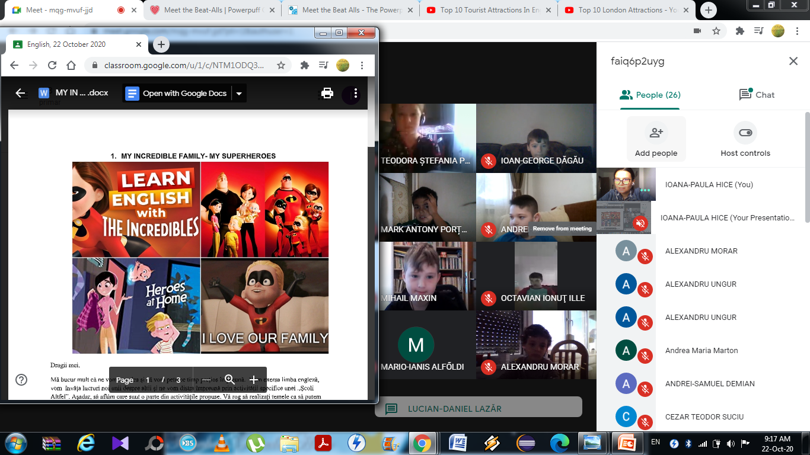
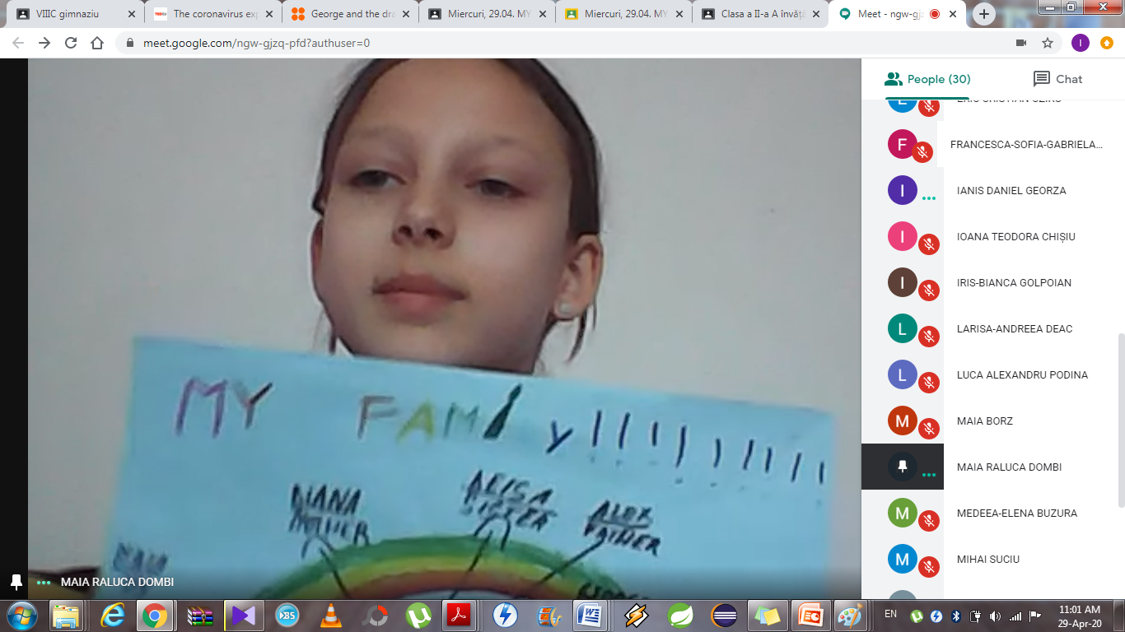
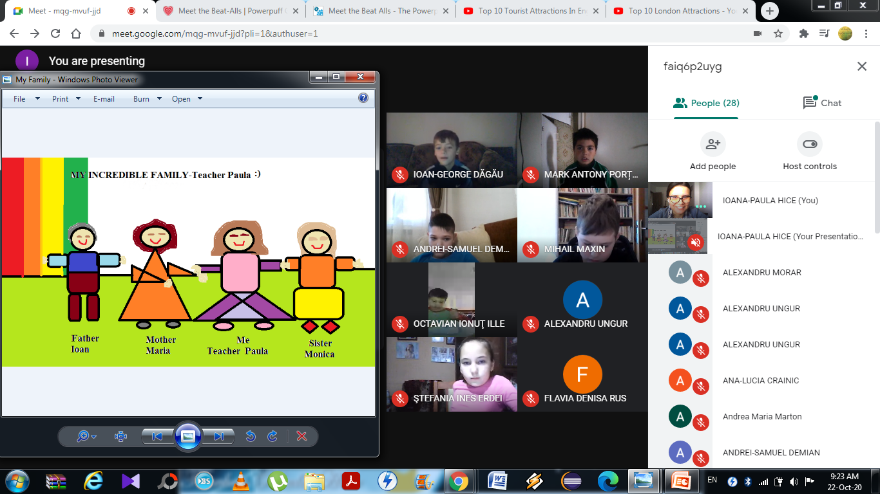

Slide 11
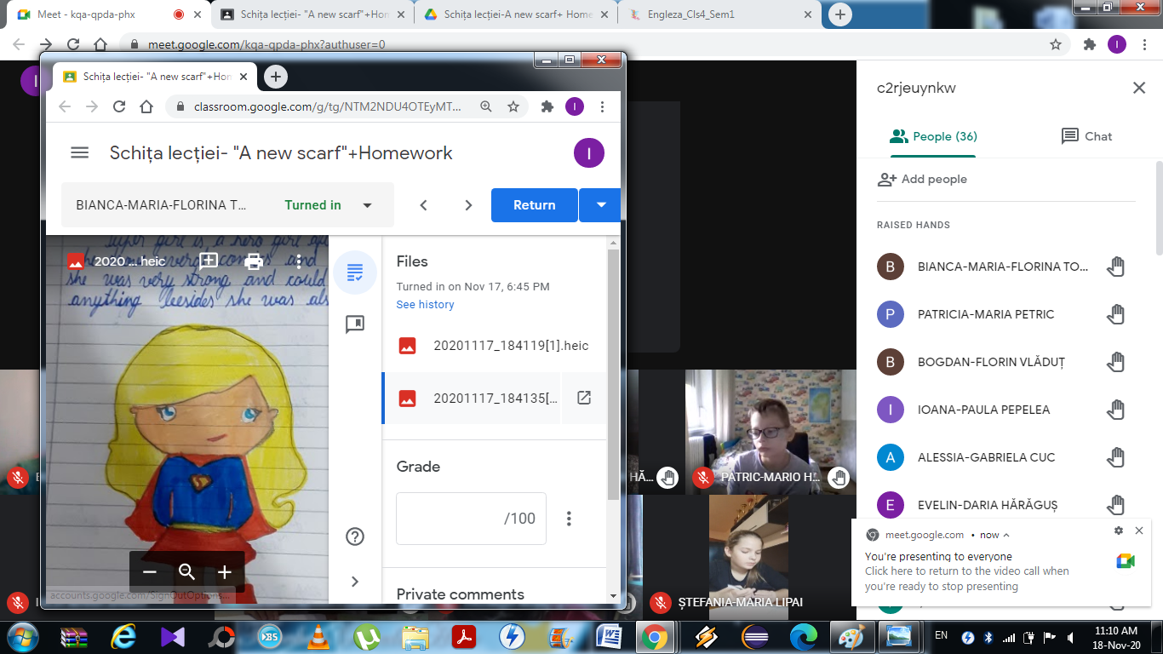
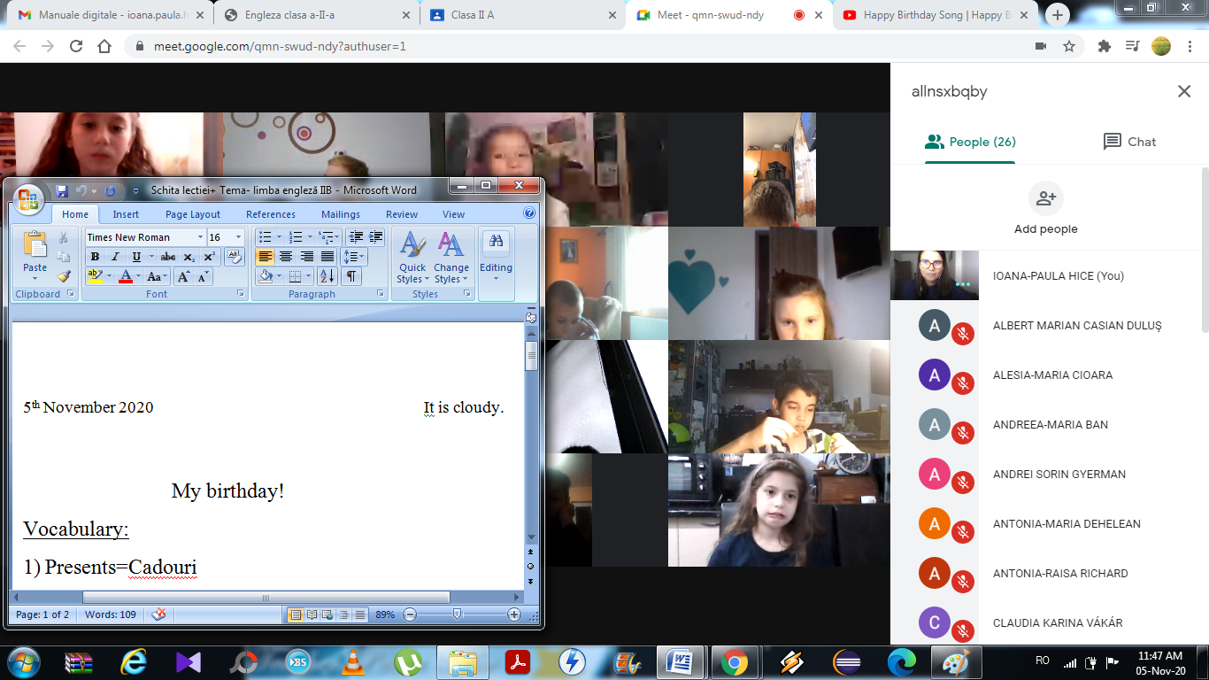
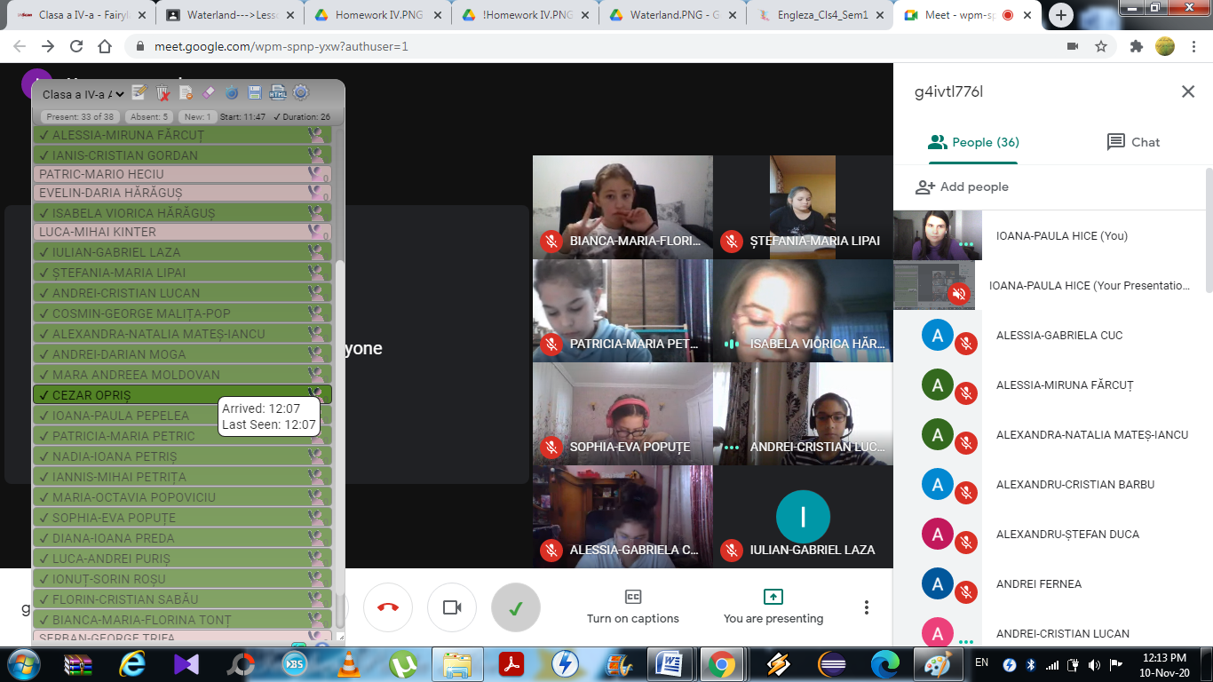
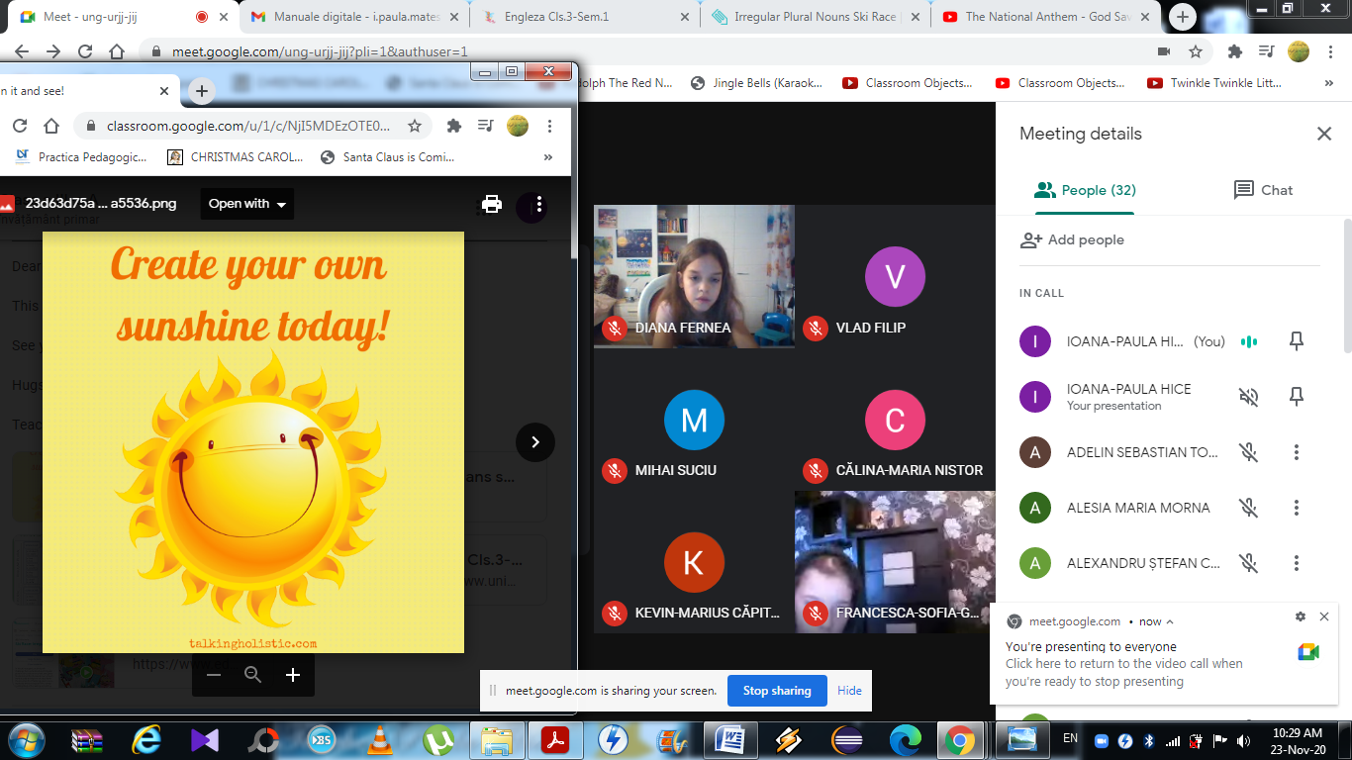

Slide 12
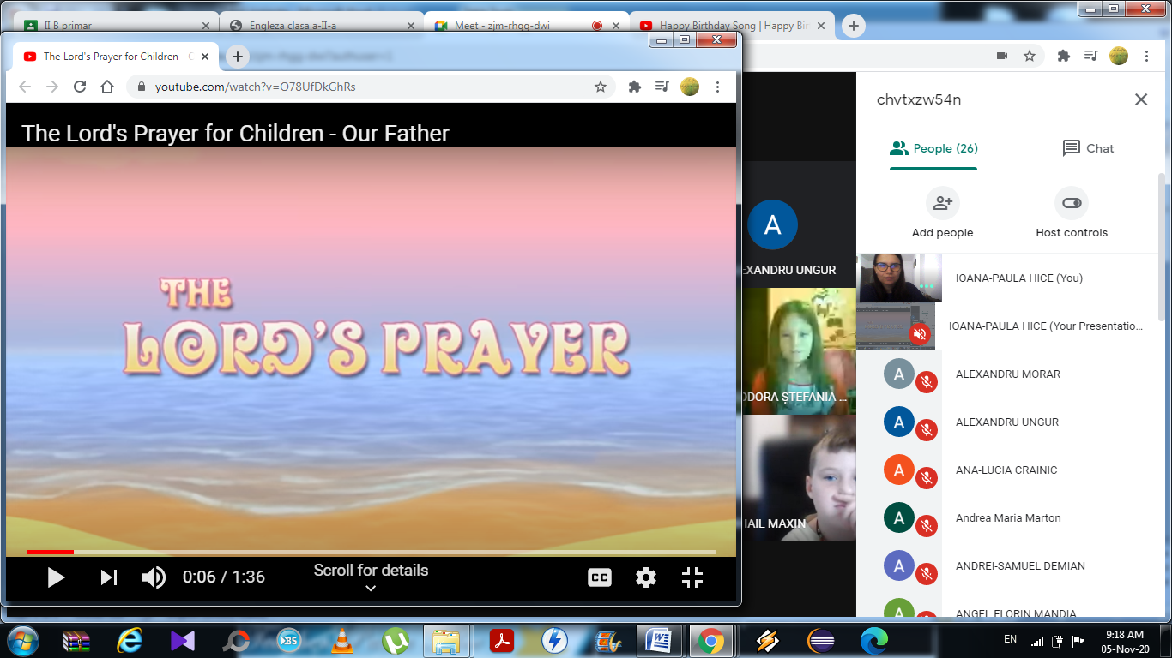
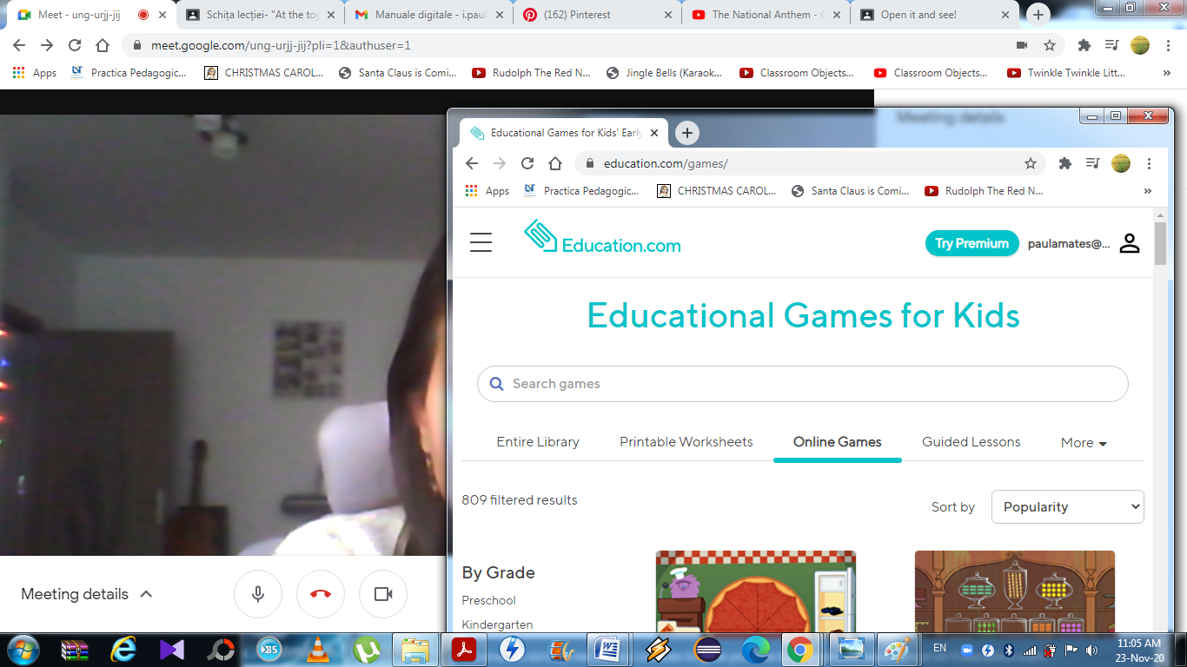
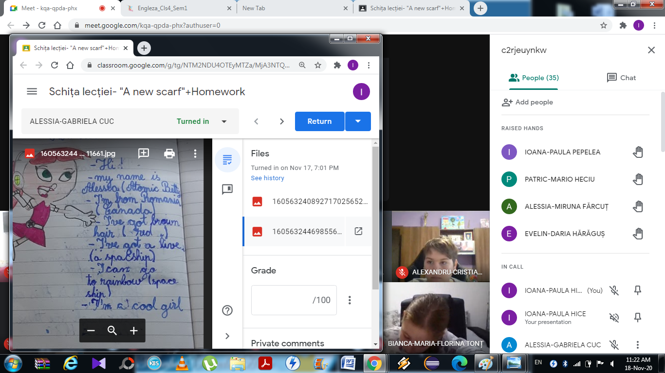

Slide 13
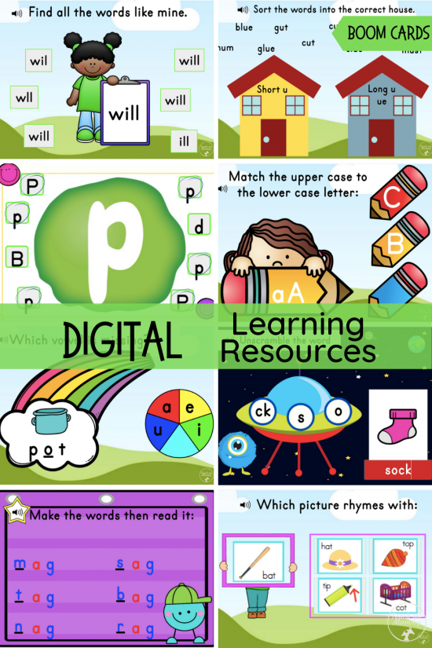
RESOURCES:
0. MY SCHOOL:
http://learnenglishkids.britishcouncil.org/word-games/school-things-1
1.THE ALPHABET:
http://learnenglishkids.britishcouncil.org/games/abc-countdown
2. THE COLOURS:
http://learnenglishkids.britishcouncil.org/word-games/colours
3. MY FAMILY:
http://learnenglishkids.britishcouncil.org/word-games/family
4. MY BODY:
http://learnenglishkids.britishcouncil.org/word-games/parts-the-body-head
http://learnenglishkids.britishcouncil.org/word-games/parts-the-body-2
http://learnenglishkids.britishcouncil.org/word-games/parts-the-body-1
5. MY HOUSE:
http://learnenglishkids.britishcouncil.org/word-games/rooms

Slide 14
6. MY BIRTHDAY:
http://learnenglishkids.britishcouncil.org/word-games/birthdays
7. MUSICAL INSTRUMENTS:
http://learnenglishkids.britishcouncil.org/word-games/musical-instruments-1
8. ANIMALS:
https://www.eslgamesplus.com/animals/
9. NUMBERS- 0-20:
http://learnenglishkids.britishcouncil.org/word-games/numbers-11-20
http://learnenglishkids.britishcouncil.org/songs/dinosaur-1-10
*
10. Food:
https://learnenglishkids.britishcouncil.org/category/topics/food
https://learnenglishkids.britishcouncil.org/word-games/food-1
https://learnenglishkids.britishcouncil.org/word-games/food-2
11. Drinks:
https://learnenglishkids.britishcouncil.org/word-games/drinks
*
EDUCATIONAL TV SHOWS:
https://www.davincikids.tv/ro/tv-schedule/?fbclid=IwAR3JNPPDgMQ1qTtX6IPaBzFd8-g34CgvJePv956m5dPcQsSrZwoBUZXau0E
GOOD LUCK!

Slide 15
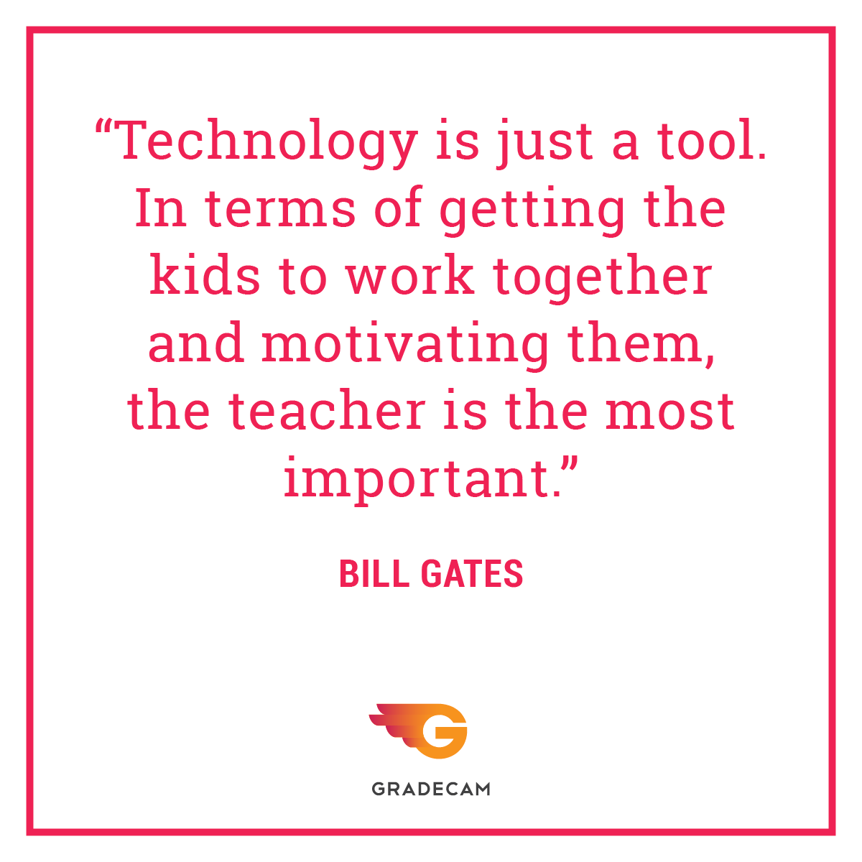
THANK YOU! ☺
…and DON’T FORGET!

