Slide 1
Traditional School Online:
Is That Even Possible?
Mureșan Dorel-Aurel
Colegiul Național ”Mihai Eminescu”

Slide 2
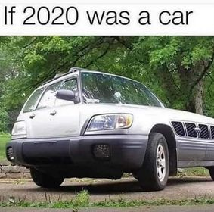

Slide 3
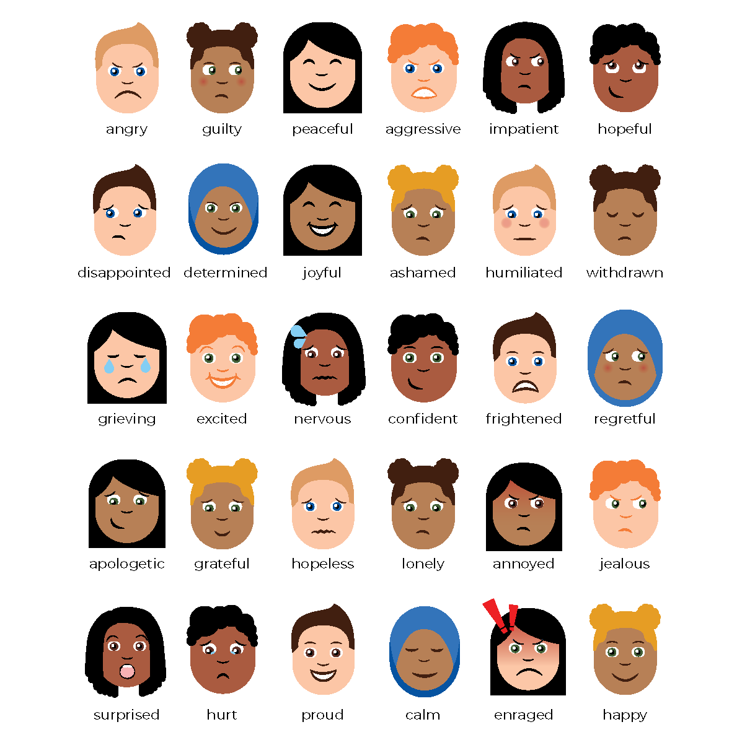
1
2
3
How does online teaching make you feel?
4
5
6
7
8
9

Slide 4
Online Teaching Involves:
New challenges
–
New perspectives
Technology
Materials for online teaching
Students’ engagement
Time management
Different learning environment
Parents’ supervision
Screen exposure
Wide variety of teaching tools

Slide 5
We Had to
Adapt
Lessons
Materials
Activities
Interaction
Time
Assessment

Slide 6
Is the lesson the same?
Or
Should it be the same?

Slide 7
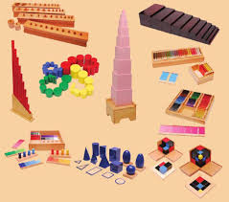
Objectives
Stages
The same lesson
in a different environment
Variety of materials
Wide array of activities
Assessment
Feedback

Slide 8
Lead-in activities
Pictures
Videos
Games
Songs

Slide 9
What Have We (my students and I) Been Doing?
Using course books
Using notebooks
Following patterns/Having routines
32

Slide 10
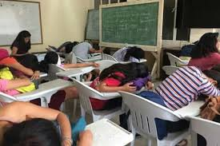

Slide 11
Why do I think “traditional” classes are important?
FOR LEARNERS:
Gives them a sense of expectation.
Offers the possibility of self-study.
Creates a feeling of safety and order.
Makes them sure they are on the right path towards their goals.

Slide 12
Why do I think “traditional” classes are important?
FOR TEACHERS:
Creates a feeling of safety and order.
Grants the same sense of approaching a goal
Eases things up
Offers teachers the chance to improve.

Slide 13
Why do I think “traditional” classes are important?
FOR PARENTS:
Gives them an easy way of checking on their children.
Assures them that everyone is doing their job.
Creates a feeling of safety and order.

Slide 14
Traditional School Online:
Is That Even Possible?
I think so…
Mureșan Dorel-Aurel
Colegiul Național ”Mihai Eminescu”

