Slide 1

Using online tools in teaching English
Cercuri pedagogice
26.11.2020
prof. Urs Marcela Andrea
Colegiul Tehnic
“Traian Vuia”, Oradea

Slide 2


MODES OF TEACHING ONLINE
Synchronously
Synchronous teaching is where the teacher is present at the same time as the learner(s).
Asynchronously
Asynchronous online teaching is where teaching materials are posted online, and learners work through them in their own time.

Slide 3

BENEFITS OF TECHNOLOGY AND ONLINE TOOLS
Improve engagement;
Improve knowledge retention;
Encourage individual learning;
Encourage collaboration;
Students can learn useful life skills through technology;
Develop 21st competencies;
It’s fun.

Slide 4

SOME USEFUL ONLINE TOOLS
https://create.kahoot.it/ - a game-based learning platform;
https://learningapps.org/ - a Web 2.0. application to support the learning and teaching process;
https://padlet.com/ - a virtual board;
https://www.liveworksheets.com/ - interactive online exercises;
https://www.mentimeter.com/ - interactive presentation software;
https://ed.ted.com/educator - lessons worth sharing;
https://edpuzzle.com/ - interactive content into pre-existing videos;
https://www.storyjumper.com/ - for creating story books.

Slide 5
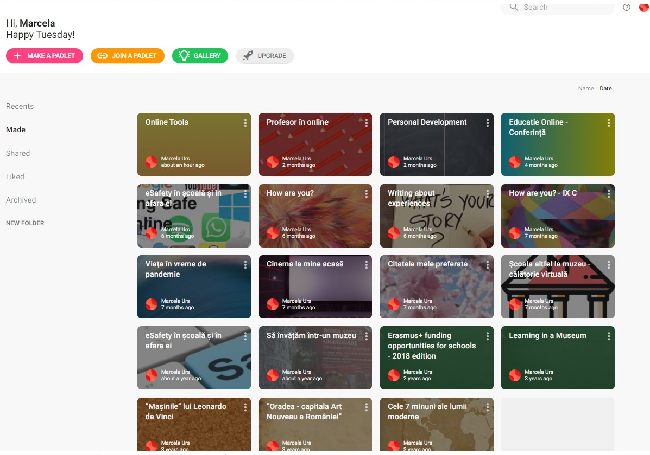
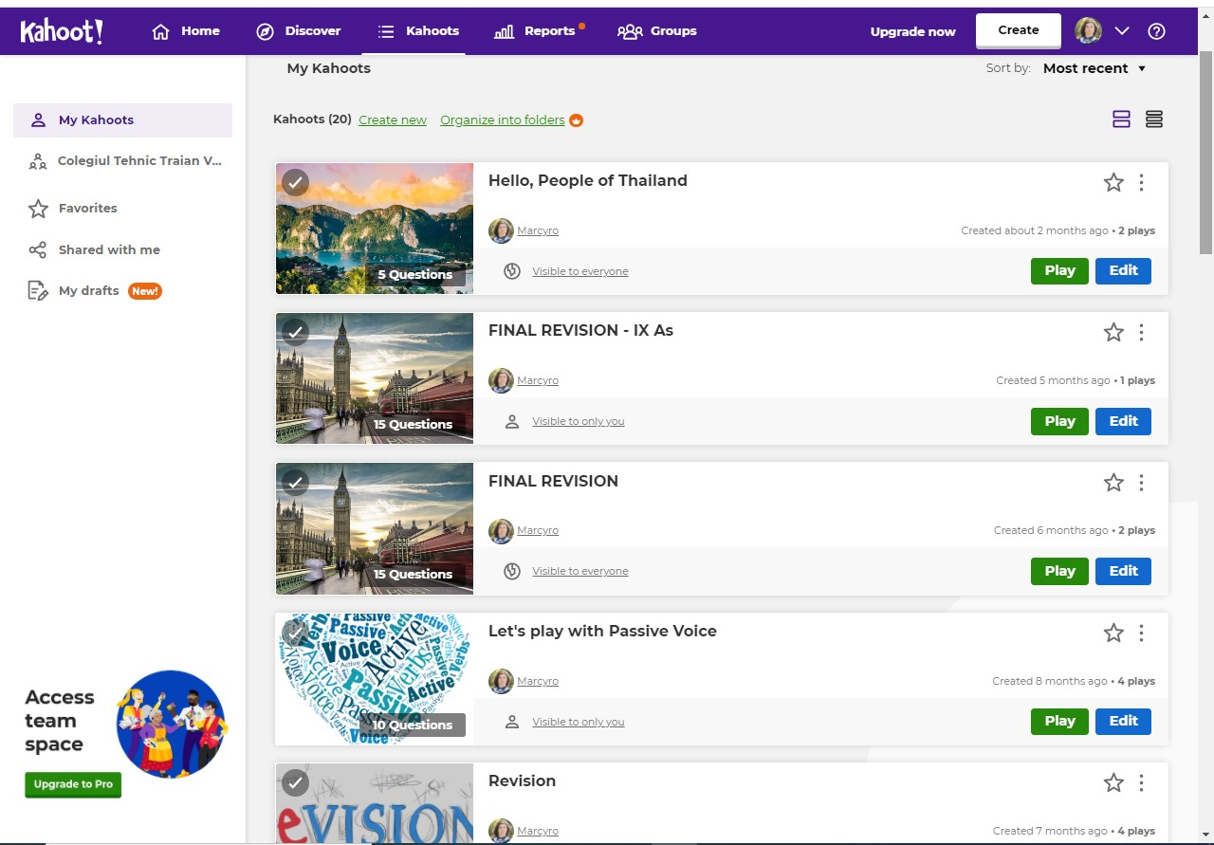

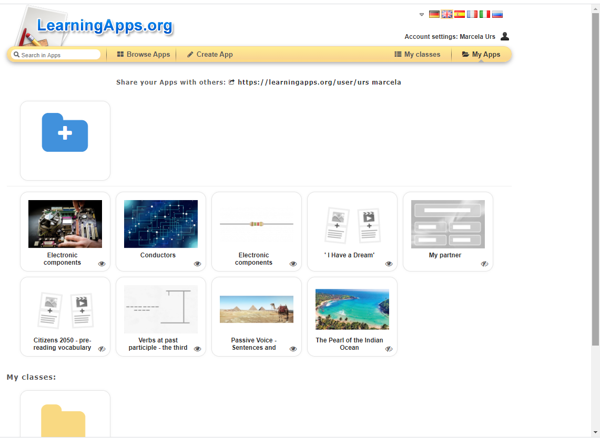
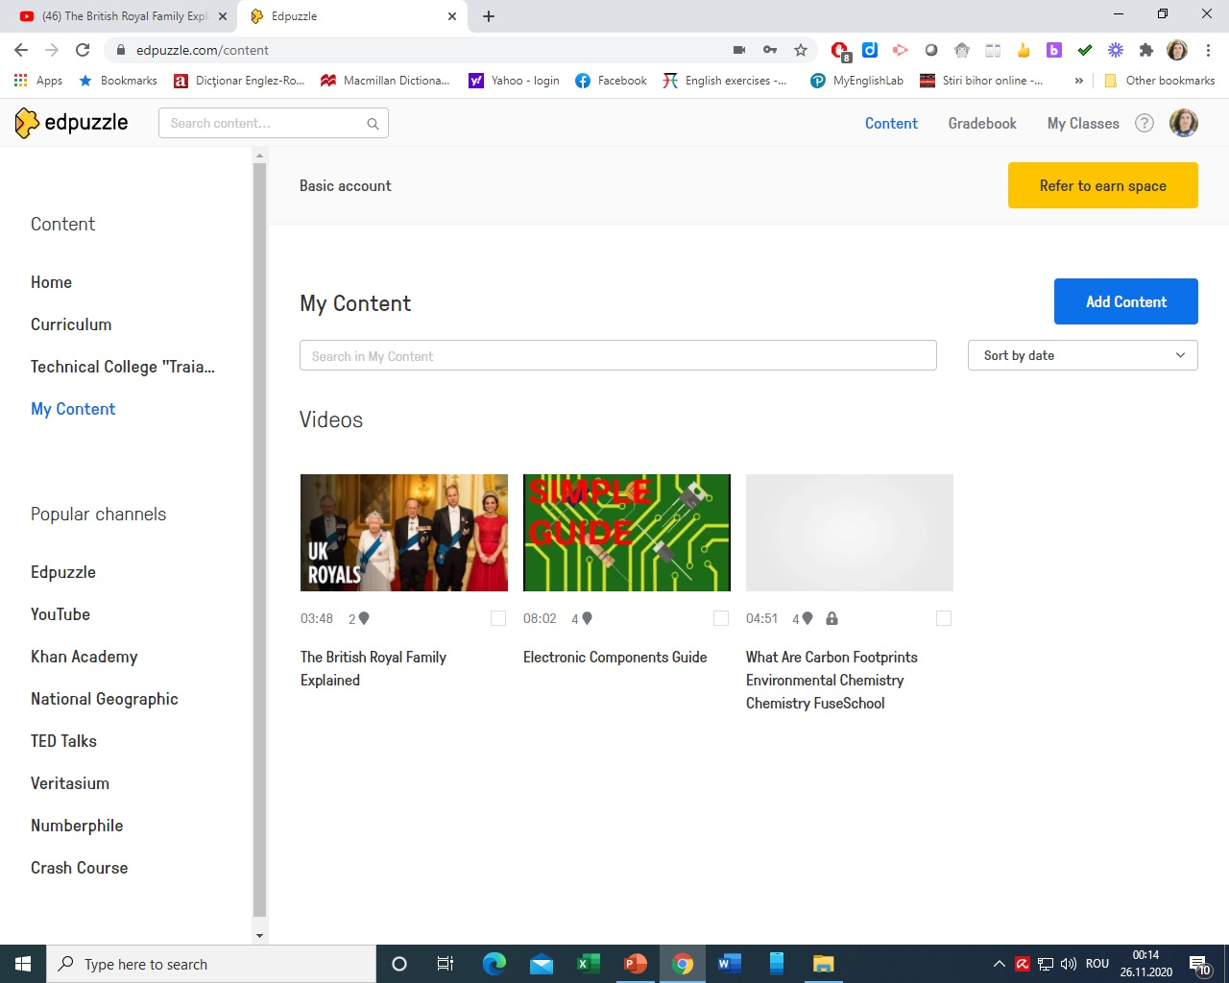
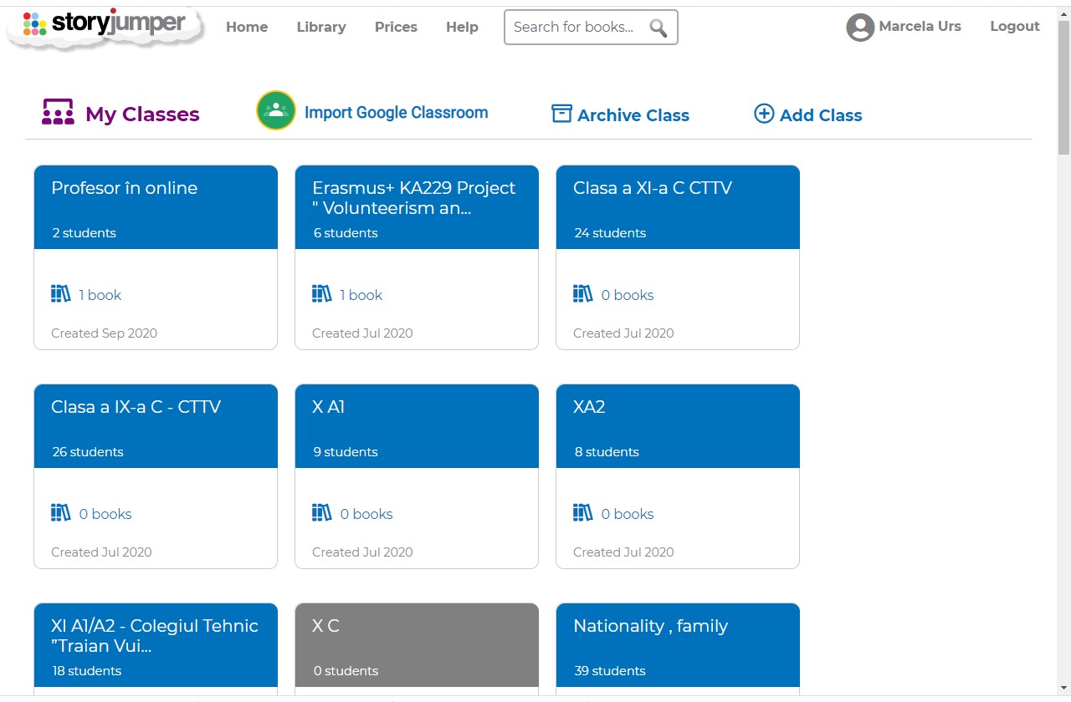
Examples of good practices

Slide 6

Edpuzzle
Here is the link to a tutorial I made for Edpuzzle
Edpuzzle is a teaching tool used to place interactive content into pre-existing videos;
You can assign an annotated video to students and check their progress in real time;
Edpuzzle can be a formative tool as the teacher can crop existing online videos and add content to target specific learning.
https://drive.google.com/file/d/1X4xJwJm_TQ00hURq8devz3y3NzXGP6ow/view?usp=sharing

Slide 7
Bibliography:
https://www.webanywhere.co.uk/blog/2016/02/top-6-benefits-technology-classroom/
https://www.kaplanpathways.com/about/news/10-benefits-of-digital-learning/
https://edpuzzle.com/

Slide 8


