Slide 1

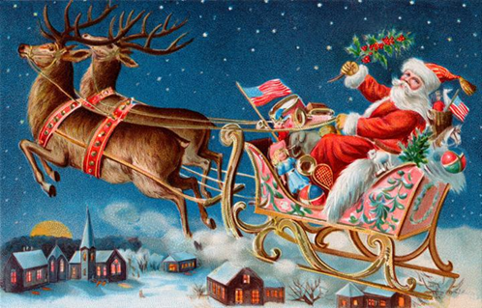
De ce iubesc Craciunul?

Slide 2
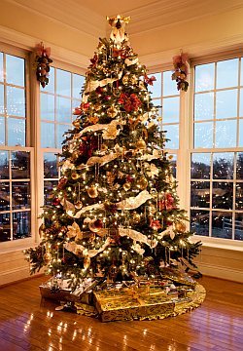

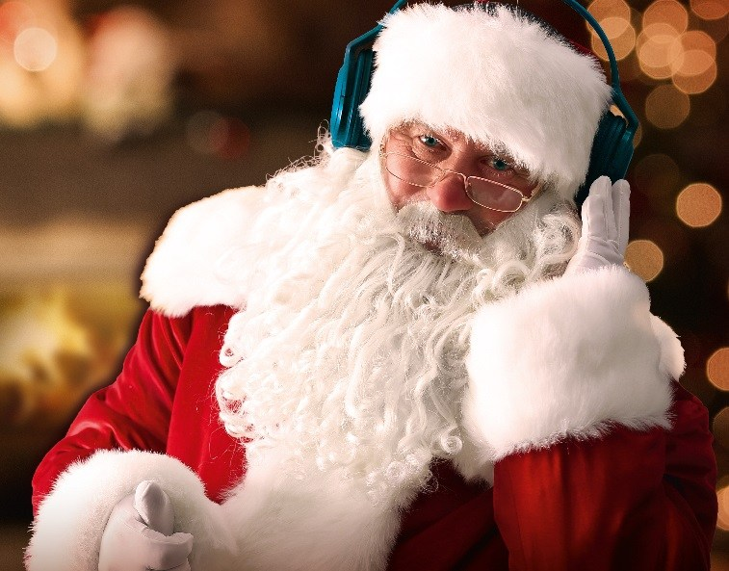
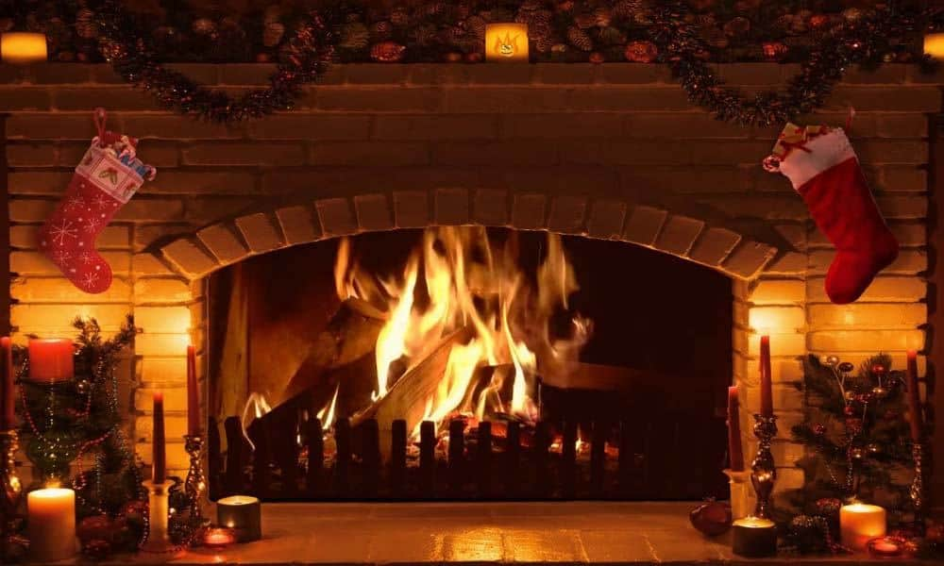

Slide 3
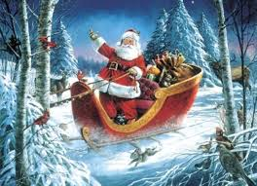
LUNI-14 DECEMBRIE ACTIVITATE INTEGRATA “VINE , VINE MOS CRACIUN” ALA1+DS1+DEC2
ID:Cine e mos craciun pentru tine? https://www.youtube.com/watch?v=v9ncdBO6Nr4&t=2s&ab_channel=GOSNEAVERONICA&fbclid=IwAR35H4QF_zYS8hED9uxVjB2oB3KakYa3R9Aq6DCpp5br6_w_ZFqcNZxnO5k
ALA1:STIINTA: MOS NICOLAE SI MOS CRACIUN-DIFERENTE https://www.youtube.com/watch?v=mzeWdcNlEo4&feature=youtu.be&fbclid=IwAR29zlbM479tR9mO0p03ra_N-jb3TgaaTdyYxCkSQ19_oNDKKf3SH_OS30U
JOC PUZZLE:https://www.jigsawplanet.com/?rc=play&pid=05655bb175f2&fbclid=IwAR2Vd_fSs-BdY9CPrqYebQV7ynOctJuk1NUG2VTNGcQDOThfpDJ0r8BJ1l8 adE:DS1:”LEGENDA LUI MOS CRACIUN” https://www.youtube.com/watch?v=zMn3WAXgtrE&feature=share&fbclid=IwAR2Vd_fSs-BdY9CPrqYebQV7ynOctJuk1NUG2VTNGcQDOThfpDJ0r8BJ1l8
PAG.44
DEC1:CANTEC:”MOS CRACIUN https://www.youtube.com/watch?v=2K_Xv34hI4c ala2:”Joc cu text si cant”daca vesel se traieste” https://www.youtube.com/watch?v=H-5Axdbw5QM

Slide 4
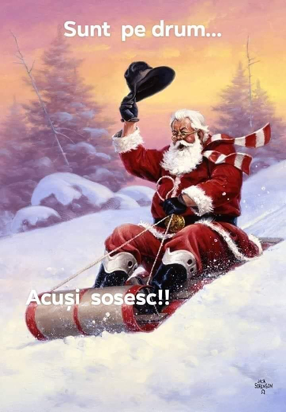
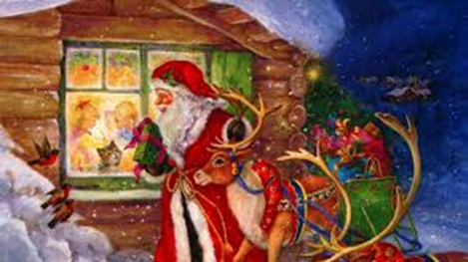
MARTI 15 DECEMBRIE” ACTIVITATE INTEGRATA “DARNICUL MOS CRACIUN”ALA1+DS2+DLc id:ce cadouri doresti sa ti aduca mosul? https://wordwall.net/ro/resource/4019198/salutul-de-diminea%c8%9b%c4%83 ala1: PUZZLE MOSCRACIUN https://www.jigsawplanet.com/?rc=play&pid=12a029e00417&fbclid=IwAR0uZrgZmpukUta8xNHWh_wZW2YgTnR7x4Xm5bzVRUy2sr7H7DvAyI0Jrg8 arta:scrisoare pentru mos craciun-desen ade:ds2:”darnicul mos craciun” PAG. 62 https://www.youtube.com/watch?v=Pi9J13yRd3g&ab_channel=KikiRikiLoco dlc: “UITE ,vine mos craciun “DE O. CAZIMIR +POEZII-memorizare PAG.45 https://www.youtube.com/watch?v=5Uwic4QAzBM”+fisa-alcatuim propozitii ala2:dansul mosilor de craciun din lumea intreaga https://www.youtube.com/watch?v=dxYJe8wkyA8&fbclid=IwAR0kM3YhbRDdglr20JkWFd5Tr3U_foAXHanCY29-czu_UBIJ51EJrTEiUYM

Slide 5
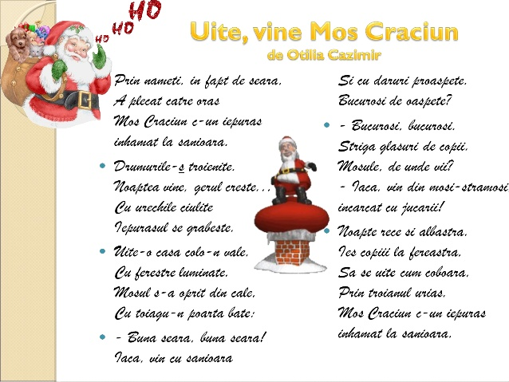
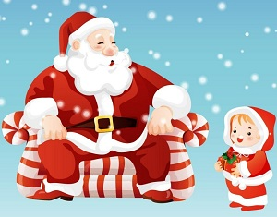

Slide 6
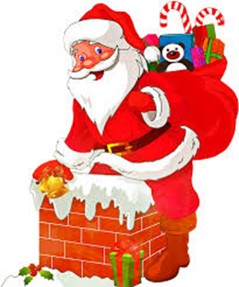
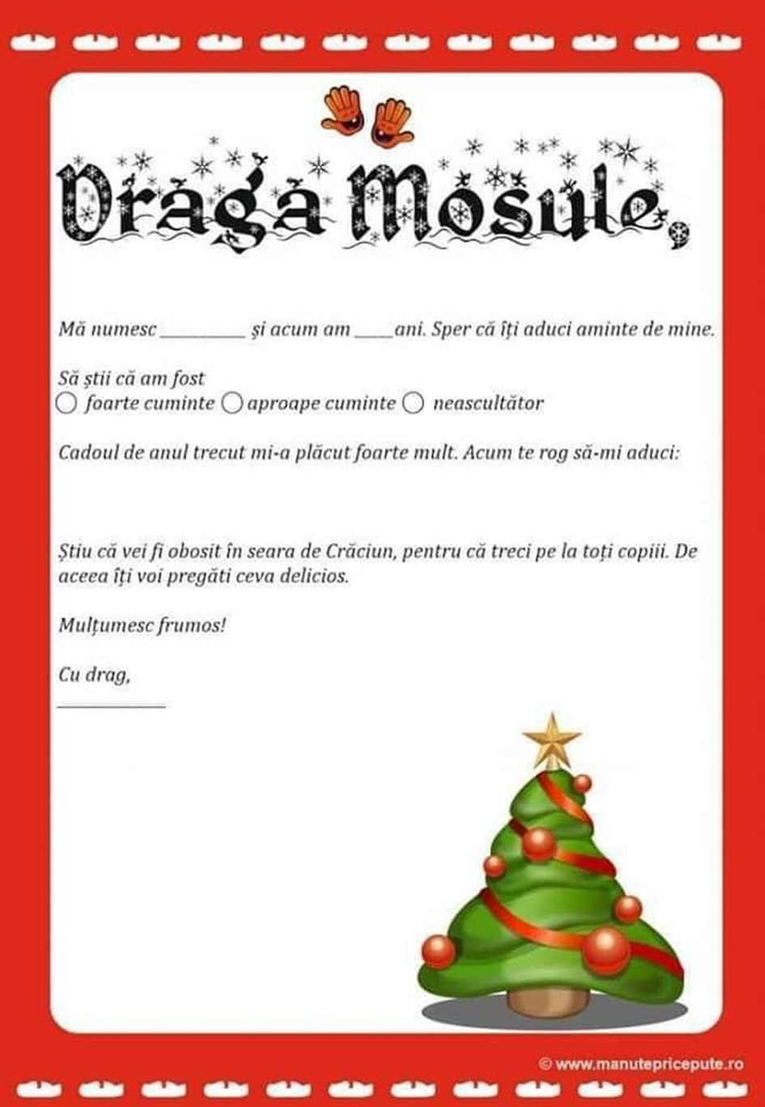
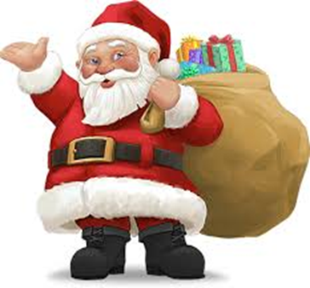

Slide 7
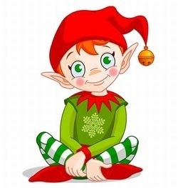

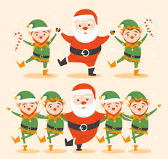
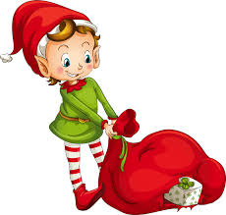
MIERCURI 16 DECEMBRIE activitate integrate “spiridusii mosului” ala1+DS2+DLC+ala2
ID:CEI MAI HARNICI SPIRIDUSI AI MOSULUI saluta -https://wordwall.net/ro/resource/4019198/salutul-de-diminea%c8%9b%c4%83
ALA1.BIBLIOTECA:ATELIERUL LUI MOS CRACIUN https://www.youtube.com/watch?v=Q2KAH_SW1AQ&feature=youtu.be
STIINTA: SPIRIDUSUL MOSului https://www.youtube.com/watch?v=zKiaMljPYbY&feature=youtu.be&fbclid=IwAR2V1FZhv7ptWY9jcYb18OIdN4n3qxCQCkf6TyAu-nSyHbvdLI6AKYhMc6Y
ADE:DS2:SPIRIDUSII DESCOMPUN CIFRA 6 https://www.youtube.com/watch?v=LaknHERHKI8 +fisa+pag.46
DLC:SPIRIDUSII AFLA SILABELE- https://wordwall.net/ro/resource/3095057/dlc-desp%c4%83r%c8%9bim-%c3%aen-silabe- +fisa+pag.45
Grafisme:litera r pag.15 din caietul de grafisme
ALA2:SPIRIDUSII LUI MOS CRACIUN danseaza -https://www.youtube.com/watch?v=DrKDl47fANE

Slide 8
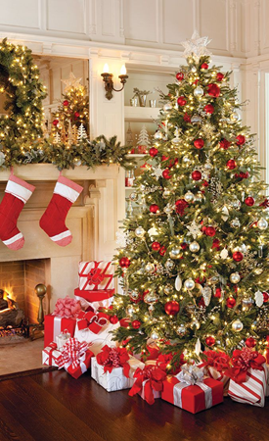
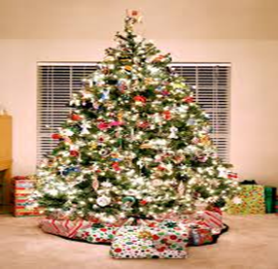
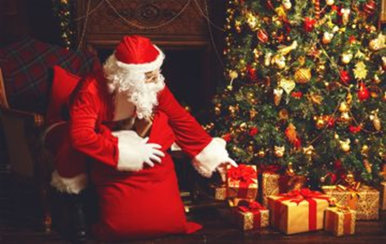
joi 17 decembrie activitate integrata “bradutul de craciun”ala1+dos1+dos2+ala2 id:cum vrei sa arate bradutul tau de acasa?-miscare si dibacie- https://wordwall.net/ro/resource/4514876/mi%C8%99care-%C8%99i-dib%C4%83cie- ala1:arta:spargatorul de nuci-prezentare interactiva https://docs.google.com/presentation/d/1tTOywPZW1n4gbedFMoy2TiFWpmWE-44vuHNet50GE0k/mobilepresent?fbclid=IwAR0-nrEL35-h3oeoYqpzI1k3mHb230r5u1W3EOETe7tMsYzjJvECPzExaqU&slide=id.gaf71f7c070_0_2 puzzle:bradutul+fisa https://www.jigsawplanet.com/?rc=play&pid=21e0001a69a0&fbclid=IwAR2t3_OqOJWEGvmr3W3b_CcLOLne3w5In2UBLJo-GQ5TYUaP1gz-SQmy3rM ade :dos1:vreau sa traiesc printre stele-povestea bradului de craciun +pag.45 https://www.youtube.com/watch?v=NSylnk28CME&feature=share&fbclid=IwAR2n3cAfqFsulp3bf92E8SlDEKJnyt3Ff8I-fcau0SXI5xeqLucQAN0OMFo dos2:bradutul dulce-aplicatie- ala2:auditie :”bradulet , bradut dragut” https://www.youtube.com/watch?v=G6sp2mvqzew

Slide 9
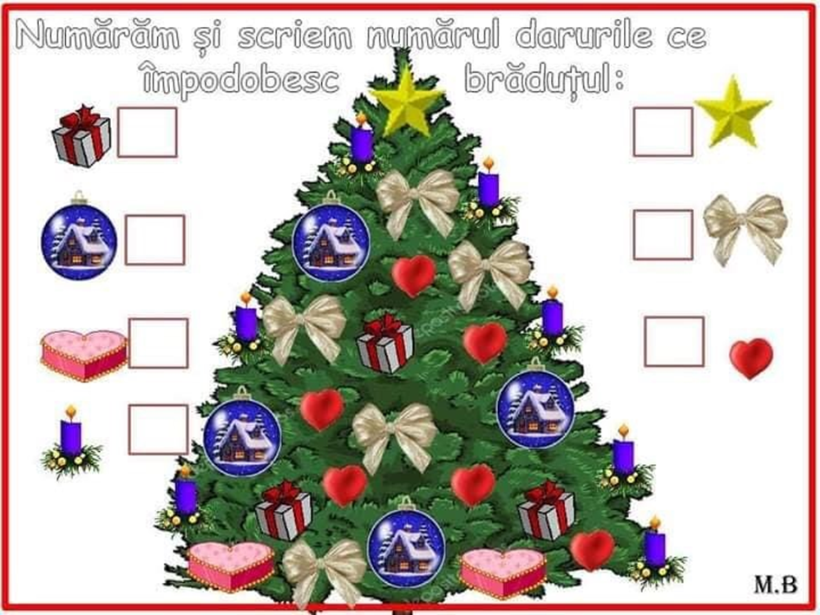

Slide 10
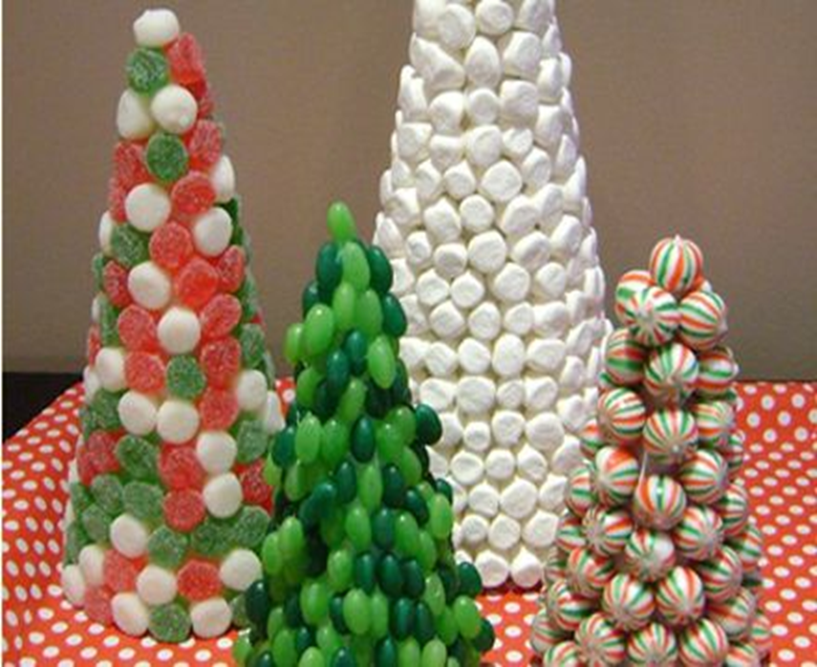
BRADUTUL DULCE
-APLICATIE-
MATERIALE NECESARE:
-O BUCATA CARTON (o rulam sub forma unui con si capsam sau lipim)
-DIFERITE BOMBOANE,ACADELE,JELEURI
-CAPSATOR
-LIPICI SAU PISTOL DE LIPIT

Slide 11
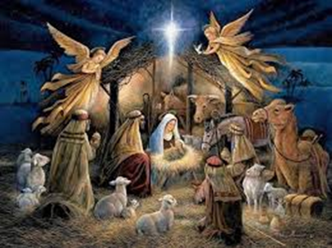
Vineri 18 decembrie activitate integrata “nasterea luisus”:ala1+ds1+dec1+ala2 id:ce I ai spune lui mos craciun?
EMOTII SI SENTIMENTE PE INTELESUL COPIILOR https://www.youtube.com/watch?v=cQwBZFkRLKs&fbclid=IwAR318Er62b8G2ASLxSyxY2OzBi1tVIH93Ky6iMWnqQTJ4LZBvA21MB3R8Ek
ALA1:Biblioteca:craciunul pe intelesul copiilor ://www.youtube.com/watch?v=J8iEsgm0DVI puzzle:nasterea domnului https://www.jigsawplanet.com/?rc=play&pid=3feea19bd48a&fbclid=IwAR0X0wLUoEy00t4CZbB4pG46whvbWRFcelra9z_v5L6aSZTaijoI8Hs9KdA ade:ds1:povestea nasterii lui isus https://www.youtube.com/watch?v=AMGKbkaZaAQ&feature=share&fbclid=IwAR2SbX2JE7dySstyIN7PozGR0pOSE8wEhfKnpYr-NE44lFCdE-D2WPxgJNI+pag.47 dec1:icoane-pictura ala2:auditie:o , ce veste minunata!-colind-https://www.youtube.com/watch?v=jWZX-yZD0DE

Slide 12
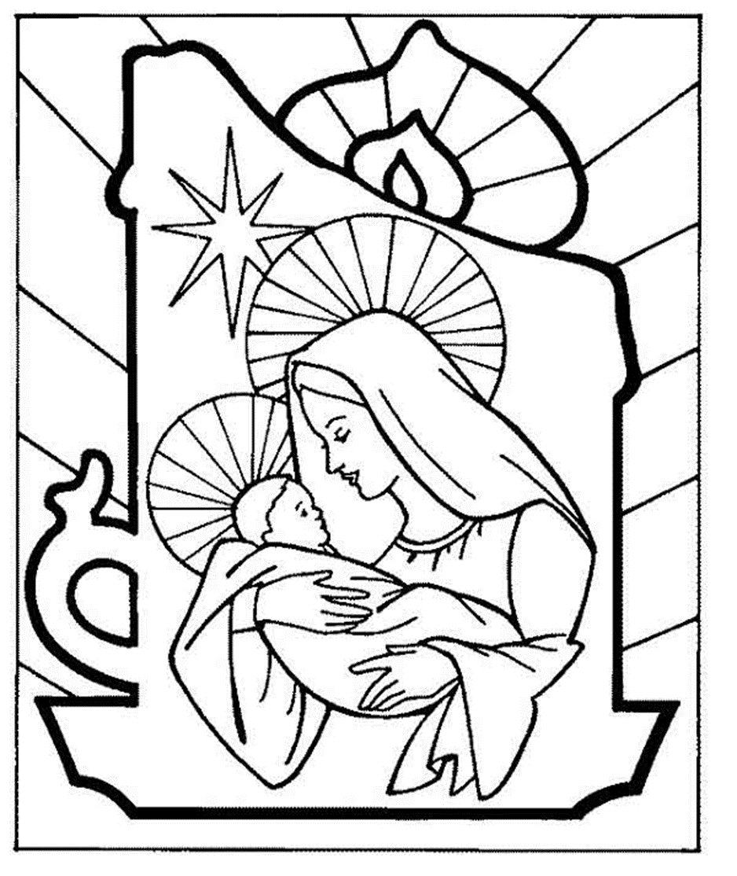
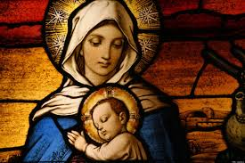

Slide 13
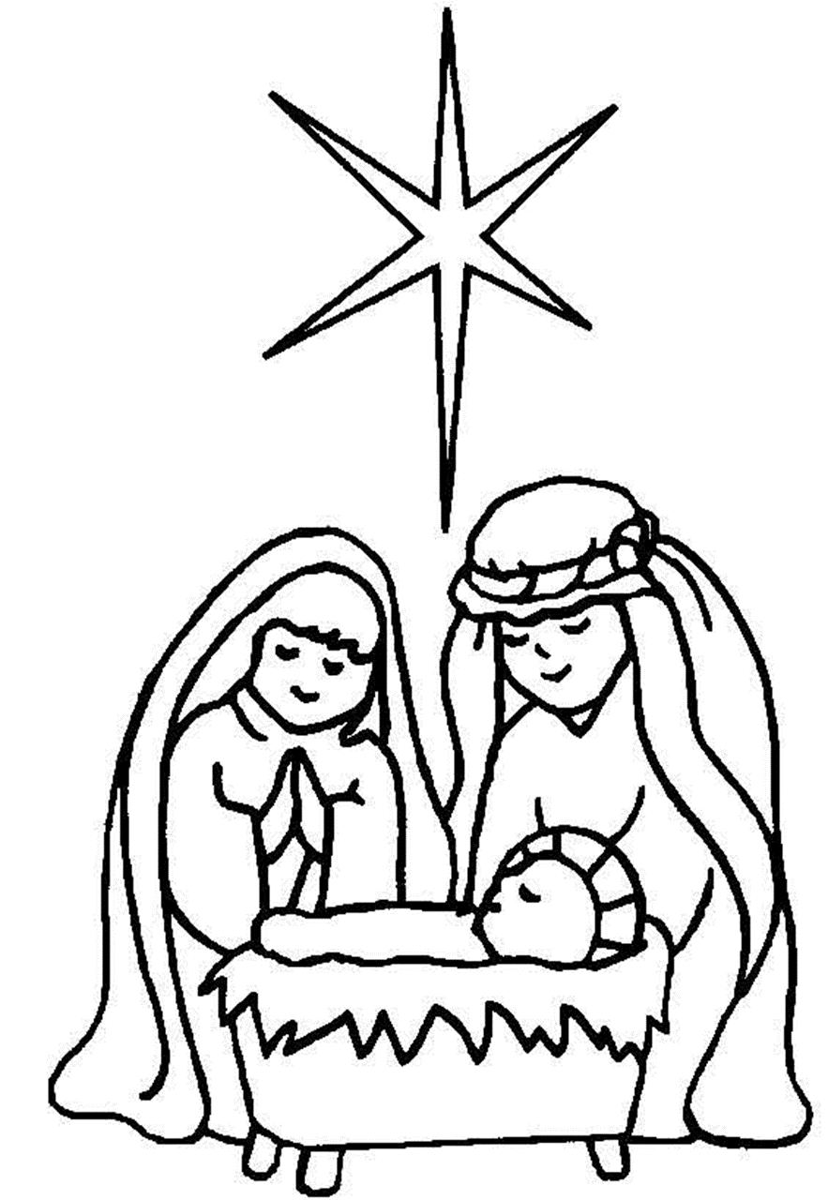
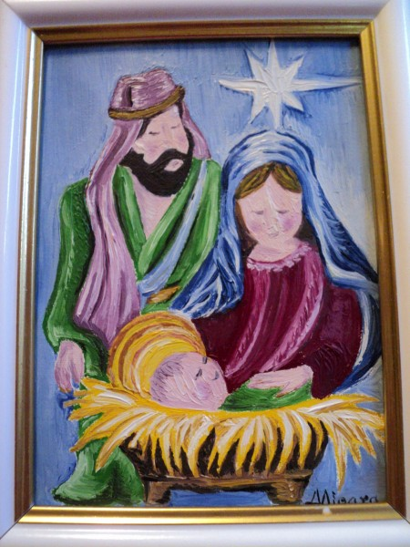

Slide 14
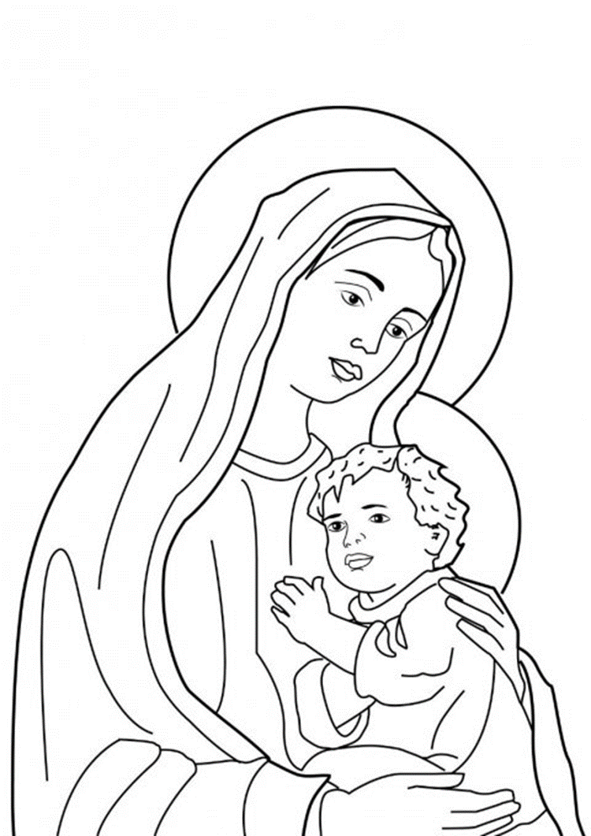
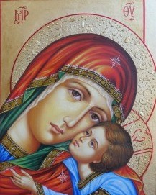

Slide 15

Va multumim din suflet , ca ne ati fost alaturi in aceasta minunata calatorie on line si va dorim : sarbatori binecuvantate!

